Slide 1
Handling Vulnerabilities
Handle Vulnerabilities Due to Software Defects and Misconfiguration
Handle Vulnerabilities Due to Human Factors
Handle Vulnerabilities Due to Process Shortcomings

Slide 2
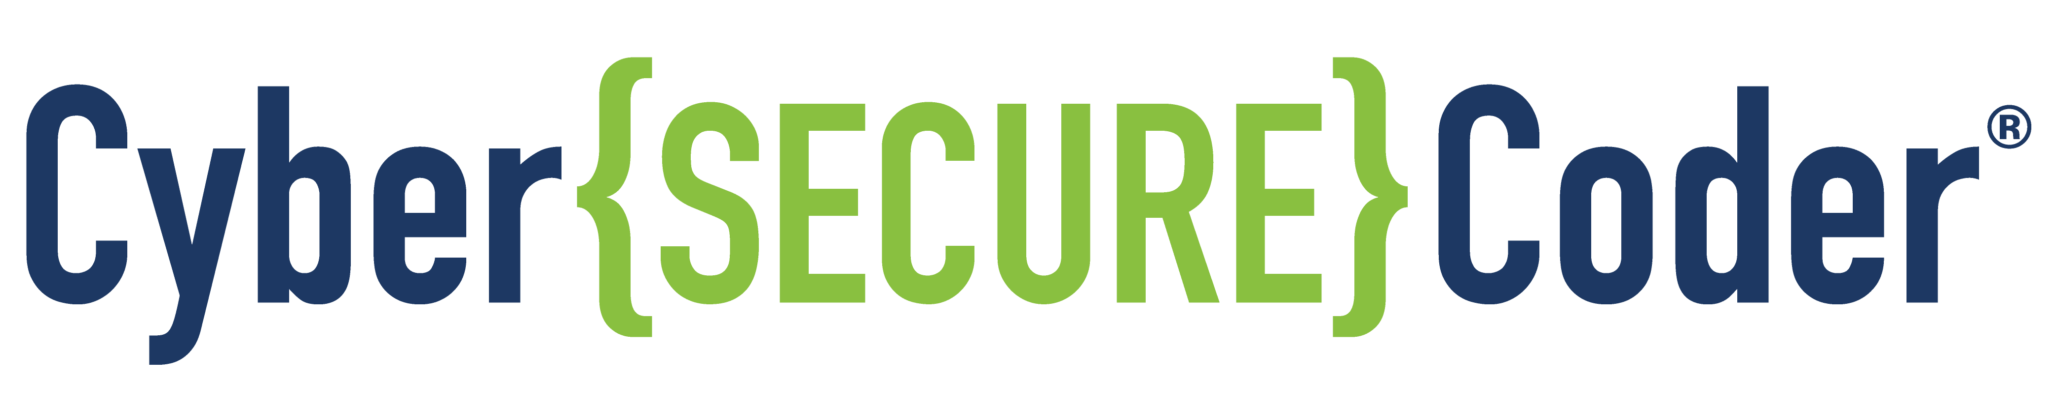
Handle Vulnerabilities Due to Software Defects and Misconfiguration

Slide 3

Software Defects
Just as software has a lifecycle, so do software defects.
Security failures after software release can be traced back to errors in design and development.
Terms that describe software problems correspond to phases of the development process.
Error—A mistake that someone makes when producing software (during design, programming, installation, configuration).
Fault—An error manifested within code. When you can point to a problem area in code that is leading to a security problem (a bug), you are identifying the fault.
Defect—A deviation from requirements (resulting from a fault)—when something doesn't work the way it should, or doesn't live up to quality requirements.
Failure—A real-world problem that occurs when a defect is released to customers.

Slide 4

Causes of Software Defects
Security defects may be placed in code maliciously.
More often, they are simply due to a development mistake, such as:
A flaw in the design, or a failure to design for security
A programming error
Mistaken or incomplete assumptions, such as:
The environment in which software will operate
How specific APIs or functions work
Access rights users will have
A change in the context in which the software runs
Using third-party code that is not secure
Bugs introduced through maintenance updates

Slide 5
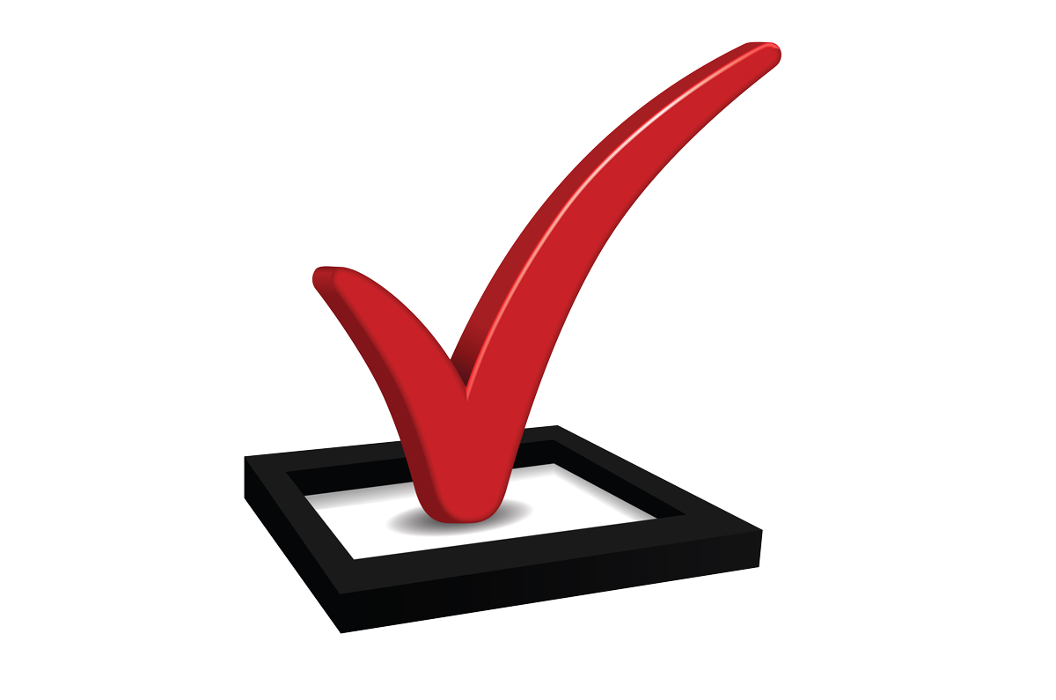
Build Security into Your Design Processes
The stronger your design early on, the less code you will have to change later on.
To build security into your design processes:
Be sure that you understand what you are trying to build.
Identify the environment in which your software will run.
Identify the major modules in your software.
List all of the errors that might occur in various modules, and how you will deal with them.
Resist adding features that are not driven by requirements.
Adhere to secure coding standards for the languages and environments you use:
SEI CERT Oracle Coding Standard for Java—https://www.securecoding.cert.org/confluence/display/java/Java+Coding+Guidelines
SEI CERT Android Secure Coding Standard—https://www.securecoding.cert.org/confluence/display/android/Android+Secure+Coding+Standard
SEI CERT C Coding Standard—https://www.securecoding.cert.org/confluence/display/c/SEI+CERT+C+Coding+Standard
SEI CERT C++ Coding Standard—https://www.securecoding.cert.org/confluence/pages/viewpage.action?pageId=637
SEI CERT Perl Coding Standard—https://www.securecoding.cert.org/confluence/display/perl/SEI+CERT+Perl+Coding+Standard

Slide 6
Prevent Coding Defects
Keep your code efficient and readable while meeting requirements.
As you code, resist adding new features that were not planned in the design process.
Pay attention to feedback from the code analysis tools provided by the debugging and development environment (lint, warnings, etc.).
Compile code using the highest warning level available for your compiler.
Improve the code to eliminate warnings.
Use static and dynamic analysis tools to detect and eliminate additional security defects
Extend the tools provided with your development environment with appropriate and effective third-party code analysis tools.
Exercise care at all input and output points (parameters passed in or out, return codes, etc.)
Validate input provided by all untrusted data sources, including command line arguments, input parameters, environmental variables, URL query strings, web POST data, and user controlled files.
Sanitize data and web output you pass to other systems (such as command shells, relational databases, and software components).

Slide 7

Identify and Correct Security Issues During Development
Scan your code and consider how you might attack it yourself. Consider, for example:
What would happen if the module is provided with unexpected inputs?
Would timing problems or delays between successive calls expose race conditions?
Does the module expose any sensitive information?
What would happen if the user has different permissions than you normally intend?
What would happen if the software runs from a different location than usual?
Lead another competent programmer through your code line-by-line, as you explain how each unit works.
Often, you'll find your own problems just by having to explain what the code does.
Others may spot problems that you don't, because you are so familiar with the code.
Develop and use a security review checklist, using lists of common vulnerabilities and attacks as a guide.

Slide 8



Activity: Preventing Security Defects
A security defect was reported in my application. After several hours recreating the problem and tracing it to the source, I figured out that the problem is in a third-party framework that I used for development. How might I have prevented this problem?
After some more investigation, I figured out that the security defect wasn't directly in the third-party component I used, but in a fourth-party component that the third-party component used. In other words, the problem was in a dependency of a dependency. With so many dependencies and sub-dependencies, how can I possibly avoid introducing security problems in my software when I use reusable components?
Developer Doris
This is the first time I've programmed in the C language. I wrote a function that manipulates some text strings using the C Standard Library strncat( ) function to append one string to another. Apparently, I misunderstood one of the parameters. While I should have specified the size of space remaining in the buffer to accept the characters I was appending, I actually specified the total number of characters in the entire buffer. As a result, I introduced a buffer overflow defect into the program. How can I avoid creating problems like this in the future?
Developer Dave

Slide 9
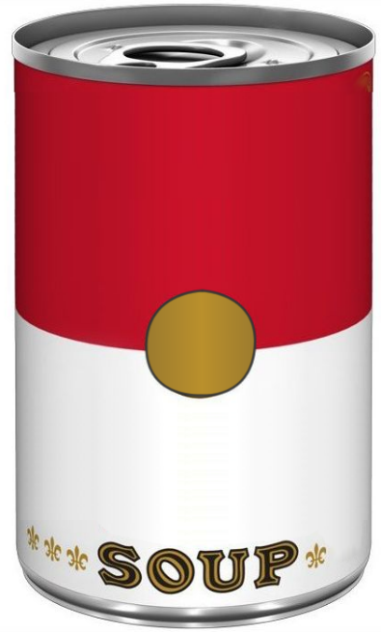
Problems in Third-Party Code
Modern applications may be a technology soup of third-party components, which may introduce security problems:
Host operating system and application runtime environment may be misconfigured
Libraries, frameworks, user interface controls, and other modules typically run with full system privileges, which may be compromised
Mobile device system and firmware which may be rooted or otherwise compromised
Cloud service APIs may be unsecure or may be used inappropriately
DEVELOPERS
CONDENSED
TECHNOLOGY

Slide 10
Problems in Standard Libraries
Standard libraries:
Provide classes, templates, subroutines, macros, global variables, and other commonly used constructs
Are included with every implementation of a programming language
Are treated by developers almost as part of the programming language itself
Are used extensively by developers
May contain functions that are inherently insecure or that can easily be used inappropriately in ways that make them unsecure
For example, some C functions are vulnerable to buffer overflows, if used incorrectly:
bcopy()
gets()
scanf()
sprintf()
strcat()
strcopy()
vsprintf()

Slide 11
Dependencies
Third-party source code libraries:
Enable developers to develop faster, using functionality developed and tested by others.
May in turn use third-party code—which would make it fourth-party code, from your perspective.
May be of very high quality, but you shouldn't simply assume that they will be.
Example:
OpenSSL Heartbleed vulnerability
Enabled attackers (using an exploit) to read the memory of the systems protected by the vulnerable versions of the OpenSSL software
Compromised services that used its encryption functionality
Was not due to a design flaw in SSL/TLS protocols, but rather a programming mistake
The mistake was in a common code library used by 66% of Internet sites
Be aware of all code dependencies your project uses (directly or indirectly), so you can monitor for vulnerabilities.

Slide 12

Encryption Validation
ENCRYPTION
Python standard libraries provide hashing but not encryption.
Most developers don't have the time or experience to develop encryption that is better than what is provided in high-quality encryption libraries.
Recommendations:
Do not write your own encryption.
Carefully select which encryption libraries you use.
Verify it uses secure protocols.
Make sure it has been tested and validated by the development community.
Popular Python encryption libraries include:
cryptography
PyCrypto
PyCryptodome
M2Crypto
PyOpenSSL
STRONG

Slide 13
Security of Host Systems and Service Providers
Cloud services:
Seem inherently less secure than on-premises, based on common-sense analysis.
In many cases, actually provide greater security than on-premises, according to evidence.
Add another layer of complexity to IT systems.
You should:
Work in cooperation with service providers to ensure security of data in transit and stored off-premises.
Research and test the security of external services that you use.
Study security guidelines for third-party services before you incorporate them into your systems.
Consider using a different service provider if they don’t have security guidelines.
Do as much as possible on your end to protect the interests of you and your customers.
Use multifactor authentication and encryption to protect data in transit or off-premises storage.
Such protections may be required by law in industries such as banking or healthcare.

Slide 14
Determine Whether to Use Third-Party Code and Services
Third-party code and service may not always simplify coding effort and save time.
Consider the following when deciding whether to use third-party code and services:
Time to develop
Effort needed to verify security and other quality attributes
Your ability to maintain and update your own software over time
Limitations on how your software can be used and distributed
Size and complexity of the project and/or deliverable
Developer support

Slide 15
Select Third-Party Code and Services for Use in Your Project
Identify your requirements
Determine whether the product meets your requirements
Evaluate developer support
Determine if other developers have many problems using it
Research its security
Analyze its security
Test its security
Avoid “lock-in”
Know the source

Slide 16
Keep Apprised of Vulnerabilities in Third-Party Code and Services
Check for new vulnerabilities in third-party resources when you release a new build.
Monitor vulnerability databases for any dependencies your software uses.
If possible:
Monitor the bug-tracking system for every library your software uses.
Identify security-related defects that are not in the NVD or other vulnerability databases.
Subscribe to RSS feeds or mailing lists to be informed of new bugs as they're identified.
Know all of your software's direct and indirect dependencies, and stay apprised of their vulnerabilities.
Know the potential vulnerabilities of languages and development tools you use, and make sure you implement appropriate protections and workarounds.
If possible:
Include dependency checks into your build process.
Use a tool such as the free OWASP Dependency-Check project to quickly compile a list of dependencies and identify those with known vulnerabilities and exploits. https://www.owasp.org/index.php/OWASP_Dependency_Check (When this course was written, this tool primarily supported Java and .NET.)

Slide 17
Host Platform Configuration
Web- and cloud-based applications rely on a host platform or service to run.
Examples: web, database, application, storage, messaging, directory services, search.
Not a direct part of your application, but contribute to the security posture.
If improperly configured, can lead to a wide variety of security problems.
System operators responsible for these services:
May not be in the same group as those developing applications that run on them.
Must work closely with developers to ensure secure configuration and maintenance.

Slide 18

Hypervisor Vulnerabilities
Many modern applications, particularly those running on cloud platforms, are designed to run on virtual machines (VMs).
VM environments are considered by some to be more secure than traditional physical machine environments because VMs:
Are logically isolated from each other.
Are transient, popping in and out of existence to perform specific short-lived tasks.
Can be taken off-line and replaced quickly.
An attack on VMs might focus on the hypervisor.
In practice, few hypervisor exploits have been identified.
The VM image could be compromised by an attacker.
Running VMs are subject to many of the same vulnerabilities as a traditional physical machine environment, so many of the security strategies used for physical machines apply to virtual machines.

Slide 19
Prevent Configuration Vulnerabilities (Slide 1 of 2)
Review all switches and configuration settings to ensure the safest possible configuration.
Remove or disable all unnecessary features:
Services, accounts, privileges, ports, etc.
Change default passwords for pre-configured accounts.
Define a repeatable (preferably automated) process to quickly and easily provision and harden the configuration of a new deployment environment.
Configure development, testing, and production environments the same way, but with different passwords.
Define and adhere to a process for monitoring and patching vulnerabilities of all services and components in each deployed environment, and performing timely updates.
Design a strong application architecture that securely separates components to minimize security problems across component boundaries in the event a misconfiguration should appear at any time.
Run scans and perform audits periodically (automatically, if possible) to help detect future misconfigurations or missing patches.

Slide 20
Prevent Configuration Vulnerabilities (Slide 2 of 2)
Use the most secure configuration for database connection strings. Use trusted connections, and do not use cleartext passwords. If possible, use a password hash instead of cleartext credentials.
Configure network transmissions to use secure encryption. Use SSL, SSH, and other forms of encryption (such as encrypted database connections) to prevent data from being intercepted or interfered with over the wire.
Configure data storage to use secure encryption. Encrypt file, object, and database storage.
Some information security policies and standards require the database on-disk data to be encrypted.
However, this is essentially useless if the database connection allows clear text access to the data.
Configure passwords to be stored only in a non-reversible format.
If possible, configure services to not store sensitive data such as PII and credit cards at all.

Slide 21
Prevent Vulnerabilities in Virtual Machine Infrastructure
Make sure that a patch management system is in place.
Provide the minimum access needed.
Log and review user and system activities in the virtual environment.
Pay special attention to how you configure virtual networking devices.
Consistently capture snapshots.
Carefully monitor the number of virtual machines to avoid VM sprawl.
Protect against VM escape.

Slide 22

Activity: Identifying Vulnerabilities in a Software Project
Another developer has started prototyping the Woodworker's Wheelhouse website using Node.js.
You will explore the design of the web application and start identifying what needs to be changed to improve security.
You will start by accessing the site's functionality as a user, to get a sense of how it functions and how it's put together, much like an attacker would do.

Slide 23

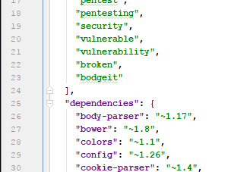
Activity: Examining the Project Files
You have explored the Woodworker Wheelhouse site's functionality.
Now you will examine the source code, looking for third-party code and other dependencies you need to research for potential vulnerabilities.

Slide 24
Error Messaging (Slide 1 of 2)
Default error messaging:
Includes such things as error messages, stack traces, database dumps, and error codes.
Is informative for debugging.
Is provided by many programming tools and components.
Identifies problems such as null pointer exceptions, network timeouts, out of memory errors, system call failures, file not found errors, and so forth.
Is generally not useful to normal end users.
Might be very useful to an attacker, as it might provide clues regarding your application's vulnerabilities.
Your approach to error handling should ensure that:
Useful debugging information is provided to developers within the development environment.
Useful diagnostic and monitoring information is logged for system operators.
Helpful messages are shown to the user.
Very little useful information is provided to attackers.

Slide 25

Error Messaging (Slide 2 of 2)
Even when error messages do not give details, subtle clues may be provided to an attacker:
How the site or software operates
What data is present behind the scenes
Thinking of ways an attacker might use information will help you spot potential leaks
Information leaks

Slide 26
Error Handling (Slide 1 of 3)
Python uses try…except blocks to handle errors:
try:
x = 1/0
except:
print('Something went wrong.')
Exceptions in try block as well as called functions:
def this_will_fail():
x = 1/0
try:
this_will_fail()
except Exception as e:
print(e)

Slide 27
Error Handling (Slide 2 of 3)
Multiple Exceptions:
try:
x = 1/0
except (ZeroDivisionError, ValueError):
print('ZeroDivisionError or ValueError is raised')
except:
print('Something else went wrong')
Optional else
try:
x = 1/1
except:
print('Something went wrong')
else:
print('Nothing went wrong')

Slide 28
Error Handling (Slide 3 of 3)
Optional finally:
try:
f = open('somefile.txt')
print(f.read())
except:
print('Something went wrong’)
finally: f. close()

Slide 29
Fail-Safe
A fail-safe system ensures that after a failure, the system is in the least harmful (or most secure) state for the data, the user, and anything else affected by the system.
A bad example:
if (IsAccessAllowed( ) == -1) {
// Inform user that access is denied here.
} else {
// Allow user to do something here.
}
IsAccessAllowed function returns:
1 if the current user is allowed access to a particular service
-1 if the user is not allowed access
0 if the function fails
If the function fails, the user would be allowed access. In this case, the function call would fail to the unsafe or more open result (allowing access).
Improved example:
if (IsAccessAllowed( ) == 1) {
// Allow user to do something here.
} else {
// Inform user that access is denied here.
}

Slide 30
Failure Recovery
Calls to the operating system, libraries, services, and APIs may return a value that indicates whether the call succeeded or failed.
Check return values that identify whether the call succeeded or failed, and respond appropriately.
If a failure occurred due to a specific reason that you can recover from, write code to recover from it.
If the call failed and the program can't recover, then:
Log the return value and cleanly terminate.
Make sure your software breaks sessions, deletes temporary files, and destroys any other resources that might be used by an attacker.
When you write code to recover from a failure:
You might program the software to retry the operation after a certain period of time.
Ensure that your code won't be put into an endless looping cycle.
Eventually, the operation should time out and fail in a secure way that releases resources.

Slide 31
Implement Secure Error Handling (Slide 1 of 2)
Exception handlers:
Place code that might throw an exception in a try block and code that handles exceptions in a catch block. (The mechanism for doing this varies from one language to another.)
Use the most specific exception for the code you're writing.
Avoid catching a fundamental exception type and handling all exception types in a generic way.
If you're using a language that supports a finally code block that is always called (whether an exception is thrown or not), then use it to return resources to the state they were in before the try block was executed.
Examples: Release connections to database/services, delete temporary files, release temporary data structures.
Functions:
Check return codes and respond appropriately when making calls to the operating system, libraries, services, and APIs.
Avoid using functions that fail silently, and find safer alternative functions.
If pass/fail return code not provided, check the return value to determine how to proceed:
Safe to perform further calculations.
Some other remediation is necessary.

Slide 32
Implement Secure Error Handling (Slide 2 of 2)
Respond to failures.
Due to an expected reason
Provide code to recover appropriately.
Due to an unexpected reason or a reason the program can't recover from
Log the unexpected value.
Cleanly terminate (break sessions, delete temporary files, destroy other resources an attacker might use).
Heed compiler warnings about missing error handlers.
Do not simply bypass the warning (by adding an empty or do-nothing error handler to squelch warnings).
Where success or failure represents a security event (e.g., unsuccessful login):
Add secure logging.
Provide notifications to system operators for security-related events.

Slide 33
Prevent Information Disclosure
Disable logging in release builds of your software.
Configure release builds to not provide core dumps.
Make sure all components, libraries, and other third-party code are configured to provide no error messages or logs that will be useful to an attacker.

Slide 34
Implement Fail-Safe Design
Denies access by default in error-handling logic for security controls.
Put limits on recovery retry attempts.
Doesn't make assumptions about ways to remediate when failure occurs.

Slide 35
Activity: Identifying Software Defects and Misconfiguration
You have:
Performed some footprinting of the Woodworker's Wheelhouse web application.
Determined various technologies that it uses.
Examined how the application is generally set up and configured, and so forth.
Now you will try out some simple attack patterns to see where the application might have problems due to defects and misconfiguration.

Slide 36
Handle Vulnerabilities Due to Human Factors

Slide 37

The Human Element in Software Security
US-CERT: “Human behavior will introduce vulnerabilities into your system.”
Security vulnerabilities may be caused by:
Malicious, disaffected, or careless end users
Well-intentioned users who are confused or uninformed
As a developer, it is helpful to be able to consider how an end user will behave.
You can't completely control user behavior.
But, you can take steps to:
Determine what users can and can't do in your application.
Inform and educate users.
Monitor and report bad behavior.
Limit potential damage.
How:
Identify vulnerabilities imposed by the human element.
Use risk management strategies to formulate a plan for dealing with them.

Slide 38
Vulnerabilities Attributed to the Human Element (Slide 1 of 2)
Using passwords that are easily broken by an attacker.
Providing credentials or access to an attacker:
Posting them in unsecure locations.
Leaving logged-in devices unattended.
Providing them directly to an attacker.
Storing files in unsecure locations.
Attaching unsecure devices to otherwise secure networks.
Leaving sensitive information on unsecure devices.
Transferring electronically secured information to unsecure outputs, such as printed hard copy.
Passing highly sensitive information in unsecure email.
Including sensitive information in a "Reply All" response that was meant to be "Reply."
Accidentally addressing the wrong recipient in a confidential email.

Slide 39
Vulnerabilities Attributed to the Human Element (Slide 2 or 2)
Disabling or circumventing software security features.
Enabling unsecure software features, such as file-sharing, remote access, and so forth.
Skipping critical security checks to save time.
Downloading and (unintentionally) installing malware.
Visiting risky websites and blindly permitting malware to gain a foothold.
Falling for scams in email, text messaging services, and social networking sites.
Allowing unauthorized people into secure locations.
Changing security-related settings that they don't understand.
Mistakes by software developers and system administrators:
Accidentally changing the configuration of a firewall or server to a less secure configuration.
Forgetting to enable or re-enable important security monitoring or logging features.
Bypassing or disabling critical security checks.

Slide 40

Social Engineering Attacks
Tailgating and piggybacking
Phishing
Spear phishing
Baiting
Click-baiting
Social media reconnaissance

Slide 41
User Input
User might:
Enter something undesirable or unexpected in:
Data entry fields within a web form
User interface control
Database field
URL query string
Cause problems such as overflowing a data buffer, confusing the system into thinking a command (rather than data) was entered, and so forth.
You should:
Inspect all data that users provide before acting on that data.
Reject or correct any unacceptable user-provided data before it can cause a problem.
input
bad
validation
good

Slide 42
Input Validation (Slide 1 of 5)
Critical security component of many applications, since it protects against some of the most dangerous vulnerabilities.
Consider developing a centralized input validation function to reduce complexity, increase consistency, and make it easier to improve and maintain.
Do not rely solely on client-side input validation since client-side code is generally easier to bypass or modify than server side.
All input to server operations should be validated on the server side.
Use client-side validation as well—to improve performance, for example.
Input validation can check for a number of factors, such as:
The type of data allowed (e.g., decimal number, currency)
The range of data allowed
The type of encoding allowed
Which characters are allowed
The minimum and maximum length of data

Slide 43
Input Validation (Slide 2 of 5)
SQL injection
%' or '1'='1'

Slide 44
Input Validation (Slide 3 of 5)
JavaScript
do​cument.wr​ite
('<if​rame scrolling="no" width="1" height="1" border="0" frameborder="0" src="hxxp://43kaylia.eu/xxx1/kqxleqjpcoh8.php"></iframe>')

Slide 45
Input Validation (Slide 4 of 5)
XML Parsing
<?xml version="1.0"?>
<!DOCTYPE lolz [
<!ENTITY lol "lol">
<!ENTITY lol2 "&lol;&lol;&lol;&lol;&lol;&lol;&lol;&lol;&lol;&lol;">
<!ENTITY lol4 "&lol3;&lol3;&lol3;&lol3;&lol3;&lol3;&lol3;&lol3;&lol3;&lol3;">
<!ENTITY lol5 "&lol4;&lol4;&lol4;&lol4;&lol4;&lol4;&lol4;&lol4;&lol4;&lol4;">
<!ENTITY lol6 "&lol5;&lol5;&lol5;&lol5;&lol5;&lol5;&lol5;&lol5;&lol5;&lol5;">
<!ENTITY lol7 "&lol6;&lol6;&lol6;&lol6;&lol6;&lol6;&lol6;&lol6;&lol6;&lol6;">
<!ENTITY lol8 "&lol7;&lol7;&lol7;&lol7;&lol7;&lol7;&lol7;&lol7;&lol7;&lol7;">
<!ENTITY lol9 "&lol8;&lol8;&lol8;&lol8;&lol8;&lol8;&lol8;&lol8;&lol8;&lol8;">
]>
<lolz>&lol9;</lolz>

Slide 46
Input Validation (Slide 5 of 5)
LDAP Query Injection
String ldapSearchQuery = "(cn ="+ $userName + ")"; System.out.println(ldapSearchQuery);

Slide 47
Security Policy Enforcement
An organization's security policies define such things as:
How different types of assets should be protected.
Who should be able to access specific assets or categories of assets.
How access to those assets should be monitored and audited.
If you are developing custom applications for:
An organization, you'll need to:
Ensure that your software follows and enforces company policies.
Examples: Enforce password policies, password complexity, authentication requirements, automatic logout after a certain period of inactivity, and so forth.
A specific platform (mobile app store, cloud services, etc.), you’ll need to:
Meet certain security provisions in your software.
May limit what users can do.
May limit capabilities you can provide in your software.

Slide 48
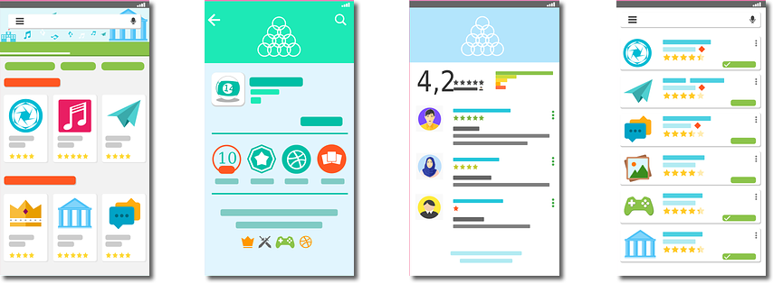
Design the User Interface for Clarity and Simplicity
Visibility of system status
Match between system and the real world
User control and freedom
Consistency and standards
Error prevention
Recognition rather than recall
Flexibility and efficiency of use
Aesthetic and minimalist design
Help users recognize, diagnose, and recover from errors
Help and documentation

Slide 49

Promote Secure User Behavior
Educate users to recognize and avoid risky scenarios.
Validate all user-provided input to ensure it contains no unacceptable characters, is within acceptable ranges and data length, and so forth.
When users take an unusual or risky action, warn them in a way that would make them think twice and not easily be ignored.
Make user prompts, user interface controls, and error messages as clear as possible.
Configure software settings to provide the most secure configuration by default.
If the software is deployed with default credentials, it forces users to immediately update to strong credentials.

Slide 50

Enforce Security Policies
Identify all of the organization's policy requirements that your software must conform to and enforce, before you design your software.
Identify all requirements imposed by the platform and any services your software uses, before you design your software.

Slide 51
Limit User Input
Validate input using a centralized input validation function on a trusted system (server, for example).
For web applications, validate all inputs coming from untrusted sources (user, input files, remote databases, parameters, URLs, HTTP header content, data redirects, and active page content such as Flash, AJAX, and so forth) before processing, and ensure they:
Are in a specific character set (e.g., UTF-8)
Contain the expected data types
Contain the expected data range
Contain the expected data length
Contain allowed characters
Do not contain disallowed characters, such as null bytes (%00), line control characters (%0d, %0a, \r, \n), and path modification characters (../ and ..\).
Validate that header values in HTTP requests and responses contain only ASCII characters.
Reject data sources that do not pass validation.

Slide 52
Establish and Enforce a Strong Authentication Policy
Set requirements that make a password difficult to crack:
Minimum length of 8 characters (12 characters preferred)
Complexity of at least three types of characters (upper case, lower case, numbers, special characters)
Frequent password changes
Minimum and maximum password age
Password history
For administrative or other sensitive accounts, consider password alternatives such as:
Biometrics
Smart cards and tokens
Multifactor authentication

Slide 53
Activity: Managing People Risks
Problems due to vulnerabilities in software may be made worse when users purposely or inadvertently fall prey to them or take advantage of them.
In this activity, you'll explore how human error can make a bad problem worse, and you’ll consider various steps you might take to:
Promote secure practices among end users.
Protect users from social engineering attacks.
Prevent information leakage.
Design the user interface to help protect against human error.

Slide 54
Handle Vulnerabilities Due to Process Shortcomings

Slide 55
Development Process Approaches
Different software development life cycle (SDLC) methodologies have evolved over the years.
There are many successful (and some unsuccessful) ways to manage software development projects, each reflecting a different general philosophy.
General approaches include the following.
Plan-driven methodologies
Iterative methodologies, such as Agile
Just-in-time methodologies, such as Lean Software Development (LSD)
Common development tasks are represented in most of the methodologies.
Analysis
Design
Implementation
Testing
Deployment
Maintenance
Security should be addressed in each of these tasks.

Slide 56

Building Security In (Slide 1 of 2)
The process you follow will have some impact on how and when you address security.
Example: Diagramming the flow of data to identify potential points of vulnerability.
Traditional plan-driven process: You might do this task in advance, using documentation tools and publishing the completed data flow diagram so the entire development team can refer to it.
Agile process: You might have a room whose walls are covered in whiteboards, on which the team draws their data flow diagrams. In this form, the diagrams can be quickly updated as the design evolves.
Regardless of the methodology you follow, you can adapt it to build security into each phase or aspect of development.
If security is built-in, then:
You stand a better chance of developing software that is secure to begin with.
Changes to software later will be less likely to compromise overall security.
Use standards and models to implement a secure SDLC.
SECURITY

Slide 57
Building Security In (Slide 2 of 2)
Standard/Model | Description
OWASP Software Assurance Maturity Model (SAMM) | A framework organizations can use to assess, formulate, and implement a strategy for software security. Can be integrated into your existing SDLC.
OWASP Application Security Verification Standard (ASVS) | Provides a basis for testing web application technical security controls. Also provides developers with a list of requirements for secure development.
OWASP Top 10 Proactive Controls 2018 | Describes the most important controls and control categories that should be included in every application development project.
OWASP Mobile Security Project | A centralized resource to help developers build and maintain secure mobile applications.
Microsoft Secure Development Lifecycle (SDL) | A collection of guidance, best practices, tools, and processes to help the developer build security and privacy into all phases of the development process.

Slide 58
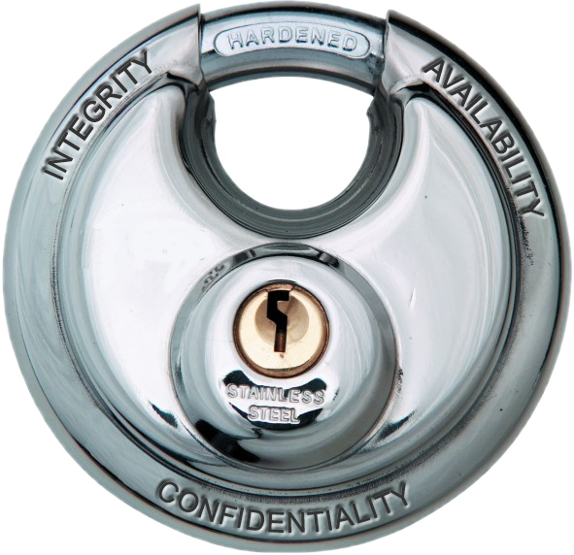
The CIA Triad
Throughout development, ensure that your software provides three aspects of security:
Confidentiality—Keep information and communications private and protect them from unauthorized access.
Integrity—Keep an organization’s information accurate, without error, and without unauthorized modification.
Availability—Ensure that systems operate continuously and that authorized users can access the data that they need.

Slide 59
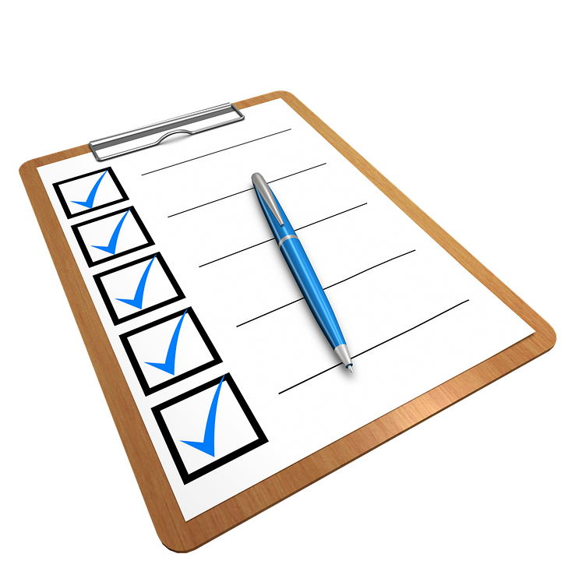
Business Requirements and Specifications
Make sure that security is part of your requirements-gathering process.
Security requirements
Ensure that software:
Will be tested for security.
Will not be considered finished until security requirements are met.
May be viewed as business requirements:
Bad security can cost the organization in legal expenses, loss of business, disclosure of proprietary data.
Are a precursor to identifying functional and non-functional requirements.
Security features and attributes should also be identified in functional and non-functional requirements.
Functional requirements:
Specify how the software should function, or behave.
Should include behind-the-scenes functions that users don't necessarily see, such as logging and support for auditing.
Non-functional requirements:
Describe quality attributes.
May address security-related qualities such as those identified in the CIA Triad.
May drive functional requirements.
Example: Non-functional requirements describing availability may lead you to identify certain functional requirements for backup and redundancy features.
Write security requirements clearly so entire development team can tell when requirements are met.
Use a checklist to evaluate your security requirements.

Slide 60
Evaluating Security Requirements
S
E
C
U
R
E
Symbiotic
Evident
Complete
Unitary
Realistic
Evaluable
Don’t conflict or contradict each other
Work together as a system
Each requirement is plain and clear
Can only be interpreted one way
Taken as a whole, the requirements communicate all security expectations for the project
Each requirement addresses one and only one thing
Appropriate
Possible
Attainable
Expressed as something that can be measured
Can be evaluated as passing or failing

Slide 61
Design Phase
Security design involves planning your app around projected risks.
Threat modeling:
Enables you to identify what needs to be done to harden against attacks.
Outlines the possible attacks that could be made on your app.
Identifies how severe each threat is and how much damage it could cause.
Focuses on how the software is structured to identify specific locations where the design is:
Vulnerable or flawed
In need of protection or improvement
Vulnerable to attack!
Vulnerable to attack!
Web page templates, images style sheets
Product Data in Database
Vulnerable to attack!
Requests
File Read Requests
File Data
Product
Data
End User
Responses
Application
Server
(Node.js)
Data Requests
End User Privileges
Database
Queries
Database Server
Site Content Administrator
Requests
Product
Data
Responses
Present product catalog and take orders
Content Admin Privileges
Web App Server Privileges
Vulnerable to attack!
Database Server Privileges
Vulnerable to attack!

Slide 62
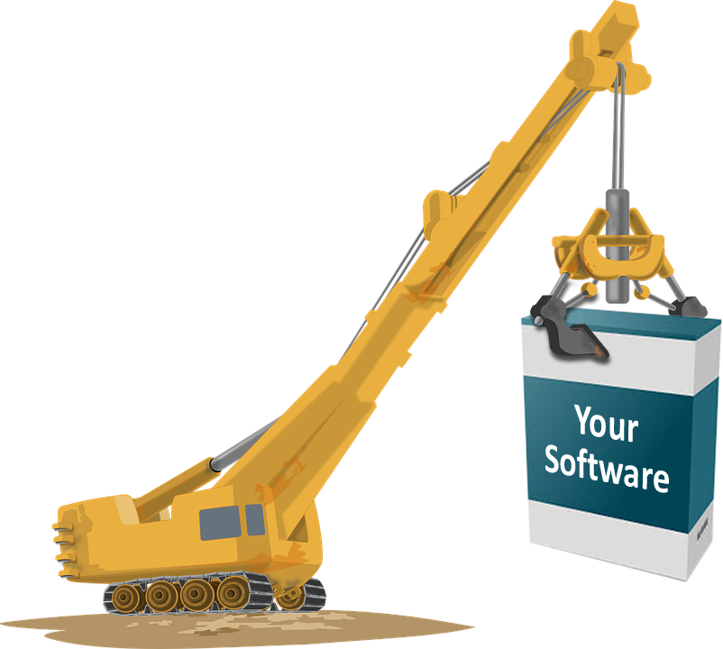
Development Phase
Deal with issues that can’t be planned for or anticipated during design phase.
Address problems as they arise.
Implement sound code based on standards you drafted during requirements and design and following fundamental principles of software security.
Use code reviews to check for various defects related to design and execution.
Have a peer review your code for security mistakes.
Use software tools to analyze for security mistakes:
Check your code against known security issues.
Use them throughout the development process as a first line of defense against common problems.

Slide 63
Testing Phase
Test early and often.
Security testing should include all three elements of the CIA Triad.
The breaker mentality should dominate this phase; push the software to its limits.
Different methods you can use to accomplish the goals set forth in the CIA triad.
Testing Method | Description
Security Functionality | Verify that the software behaves according to requirements, which should include security.
Fuzz-testing (fuzzing) | Enter a wide variety of out-of-range, invalid, random, or garbage data in an attempt to break poorly implemented input methods.
Session Management | Ensure that tokens and other session management devices can't be intercepted or abused.
Client-Side Testing | Confirm that there are no vulnerabilities in the user interface, and no information is revealed in user interface code or messaging.
Dynamic Validation | Use variable data in the code to ensure the integrity of the software.
Risk-Based Testing | Prioritize what features to test based on their potential risk and the impact of their failure.
Penetration Testing | Play the role of an attacker, finding weaknesses and attempting exploits.
Authentication Testing | Verify that communication over a network such as the Internet is protected by secure identification methods.
Regression Testing | Confirm that newer patches, updates, and fixes work with older code.

Slide 64
Security Testing Tools
Include vulnerability and exploitability tests.
Testing should be performed by a separate penetration testing team.
Tool | Description
Metasploit | A popular penetration testing and exploit framework with many plugin modules that are regularly updated. Has free community and paid commercial versions that run on Windows. The free open source version runs on Linux.
Nessus | A popular vulnerability scanner from tenable.com that runs on multiple platforms. Various free and commercial licensing options are available.
Kismet | An open source wireless intrusion detection framework, with built in device detection, sniffing, and war-driving capabilities.
OWASP ZAP | A popular open source web application security scanner.
Nmap | An open source network scanner with many features including host, service, and operating system discovery, vulnerability testing, and packet crafting.

Slide 65


Deployment Phase
When testing is complete and all issues have been worked out:
Prepare to release the software to users.
Anticipate what could go wrong before your software is released.
Establish a process by which users can report bugs or security issues.
Don't just let users discover flaws on their own without any way to inform you.
Make sure you're there to receive defect reports immediately so that you can fix the problems as quickly as possible.
Update your documentation to record what went wrong and why, so you'll be better prepared in the future.
Deployment should be done with the same attention to detail shown during all of the phases that came before.

Slide 66


Maintenance Phase
Issue patches and hotfixes to address problems both small and large.
You’ll need to plan how and when to do this.
May not be enough to wait for external feedback before making changes to your software.
Test security:
When you add new features
When you remove old features
When your code is altered in any way
When third-party code (dependencies) is altered in any way
Don't overwhelm users with updates.
Combine updates that aren't urgent.
Make sure no security issues in any software dependencies leave your software vulnerable.
Your
Software

Slide 67

Development Process Security
Design your software to be secure even if its source code were known to an attacker.
The more secrets a system depends on for security, the more prone it is to attack.
Every secret creates a potential failure point.
Security measures:
Protect your source code, documentation, and data.
Assign team members with separate responsibilities and access.
Protect development, testing, and production environments.
Architect and design
Identify requirements
Test
Deploy and maintain
Develop

Slide 68
Integrate Security into Your Development Processes
Use established OWASP models and standards to implement a secure SDLC.
Examine each phase or aspect of your development processes, and identify how you can address security.
Include security when you define scope and requirements.
Identify functional as well as non-functional security requirements.
Make sure that security requirements flow into test cases.
Use threat modeling ("architectural risk analysis") to identify and prioritize risks.
Include security reviews in the development phase.
Use code analysis tools to help identify security defects as they emerge.
Use a variety of testing methods throughout development to ensure that security problems don't appear as the project progresses.
As you fix security defects, create new automated unit tests to alert you if the problem you fixed reappears.
Establish processes and software features so you are notified immediately when security issues are found.
Establish ongoing monitoring and testing to identify when new security issues emerge over time.
Stay apprised of vulnerabilities in systems and modules that your code depends on, such as the operating system it runs on, web servers, database servers, cloud services, and so forth.

Slide 69
Follow Principles of Security Design
Openness Assume that attackers have all information they need to exploit your app.
Fail-safes Initialize to the most secure default settings, so that if a function were to fail, the software would end up in the most secure state.
Least privilege Ask only for the permissions that are absolutely needed by your app, and try to design your app to need as few permissions as possible.
Resource economy Be prudent with shared resources by limiting their use and relying only on trusted sources.
Complete Mediation Thoroughly check and double-check your code for any flaws or vulnerabilities.

Slide 70
Secure the Development Environment (Slide 1 of 2)
Keep development, testing, and production environments completely separated, and control access to them by network users and deployment scripts through different assignable roles.
If possible, separate responsibilities and access to different environments so only those who require access to a particular environment have access.
Protect development, testing, and production environments from physical access.
Protect the computers that developers use for development. For example, encrypt local storage, require developers to log out when walking away from their desk, and so forth.
Avoid using public code repositories.

Slide 71
Secure the Development Environment (Slide 2 of 2)
Make sure your code repository is on a secure system that is protected from unauthorized physical and network access.
Store code backups only in a secure storage location.
Maintain secure logs of all code check-ins and check-outs.
Monitor who accesses the repository, when, and from where.
Audit code frequently to verify that no malicious functions or vulnerabilities are added into production.
Provide developers with realistic sample data to use for programming and testing instead of actual data.
When it is necessary to destroy any source code, sensitive data, assets, or backups, make sure they are destroyed securely. Follow compliance requirements, if applicable.

Slide 72
Activity: Managing Software Development Process Risks
One of the files in the FTP directory seems to be a programming artifact left behind by a software developer.
You will try to gain access to the file as an attacker might do, and will examine the information that might be leaked by such a file.

Slide 73
What vulnerabilities will provide the greatest challenge in your own software projects?
What steps might you take to promote secure practices among your own software development team?

